Slide 1
Remote Desktop and It's Uses
Anika Marjan

Slide 2
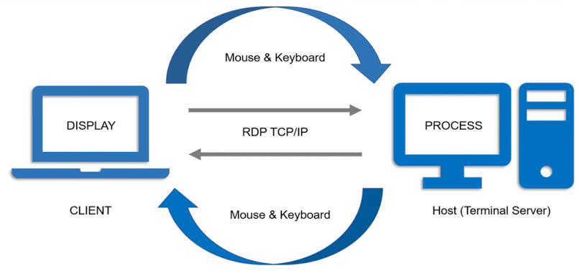
Remote Desktop
Remote Desktop allows users to access and control a computer remotely over a network or the internet.
How it Works:
Uses software like Microsoft Remote Desktop, TeamViewer, AnyDesk.
Key Components:
Host Device
Client Device
Network Connection

Slide 3
Uses of Remote Desktop
Work from anywhere
IT support
Resource Sharing
Collaboration
Cost Efficient

